Slide 1
Welsh power system studies
Key outputs from case studies
Imperial College London

Slide 2
Scenarios
No. | Scenario | Notes
1 | Central* | Similar to 100g/kWh scenario for 2030 GB system from 2015 flexibility study (includes Wylfa, 2.7 GW, no tidal lagoons)
2 | Swansea | ‘Central’ with Swansea tidal lagoon (320 MW) replacing onshore wind outside Wales
3 | Swansea + Cardiff | As in ‘Swansea’ plus Cardiff tidal lagoon (3.24 GW) replacing nuclear generation outside Wales
4 | No Wylfa | ‘Central’ without Wylfa, but with 2.7 GW more nuclear capacity outside Wales
5 | GG High PV | High PV penetration: 40 GW of PV (vs. 20 GW in ‘Central’); all additional solar beyond ‘Central’ is at LV across the UK (distributed in proportion to population)
6 | GG High PV + DSt | As in ‘GG High PV’ plus assuming 1 kW / 2 kWh of additional battery storage per each 4 kW of domestic PV
7 | Low Demand | 20% reduction of demand across the board (proxy for low electrification)
8 | High Demand* | 20% increase of demand across the board (proxy for high electrification)
9 | Low Wind | All additional onshore wind from today is in Scotland (up to 15 GW total), plus 18 GW of offshore (vs. 22+20 in ‘Central’). Compensated by increased nuclear outside of Wales
10 | Coal -> CCGT | Replacement of Aberthaw (1,569 MW) and Uskmouth (363 MW) coal plants with same size CCGT generation
* Scenarios also run for CCGT load factor limited at 60%

Slide 3
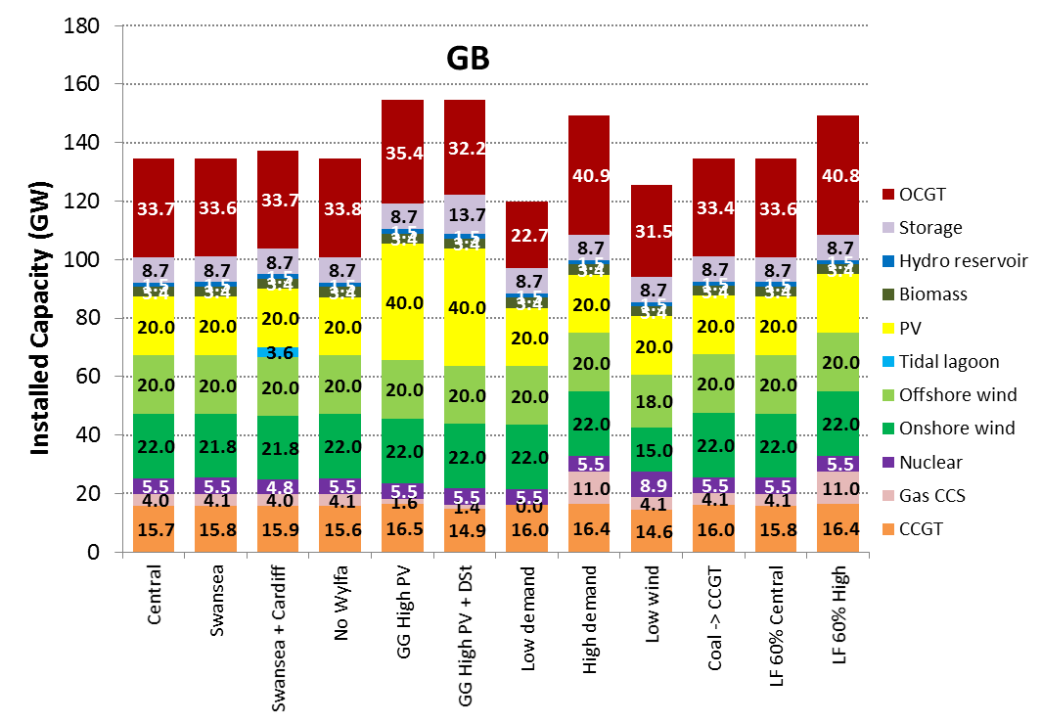
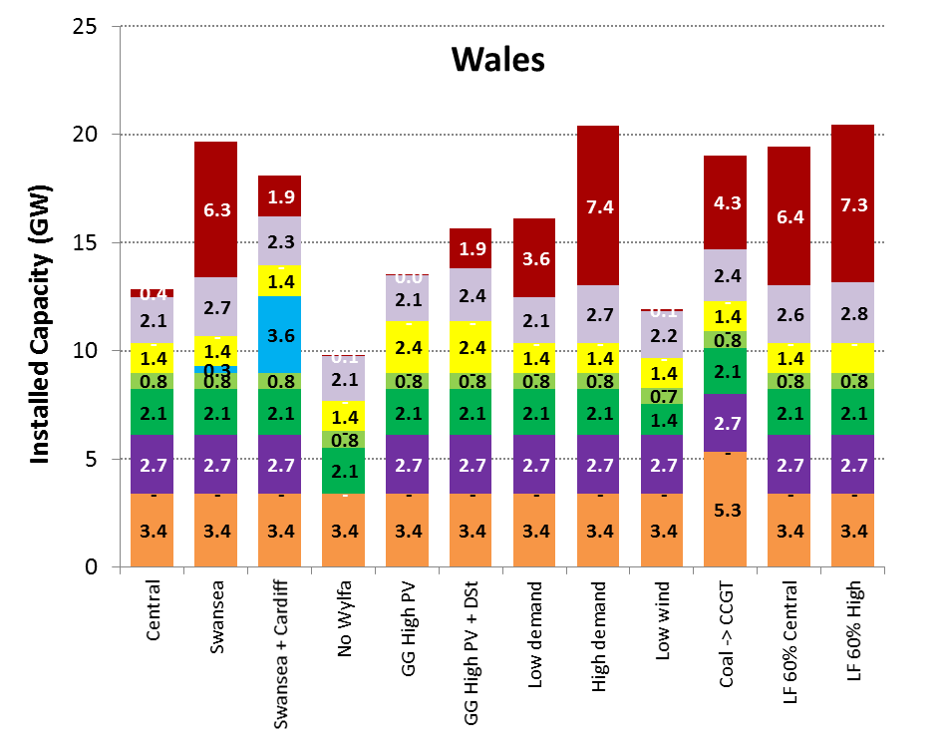
Generation capacity mix
Note: 2 GW of storage in Wales is existing pumped-hydro.
OCGT capacity is incorrect: Marko is amending.

Slide 4
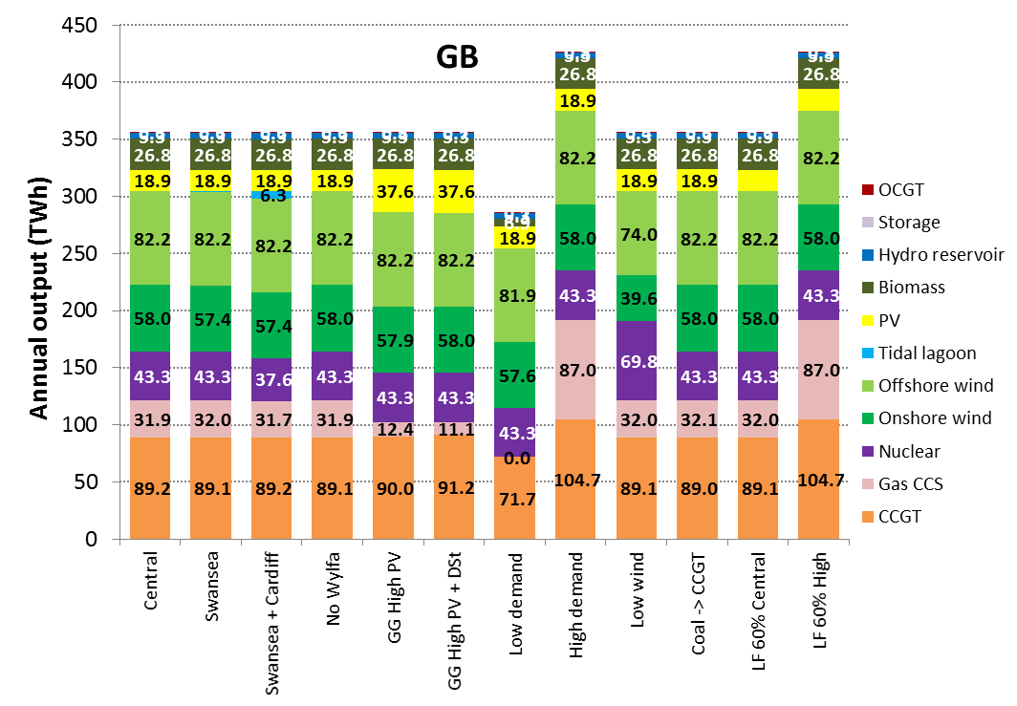
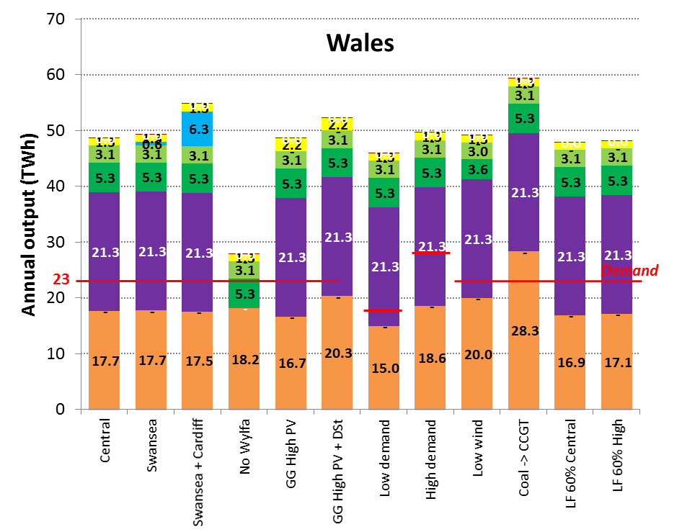
Annual generation output
→ Power generation in Wales more than double of Welsh demand (except without Wylfa)

Slide 5
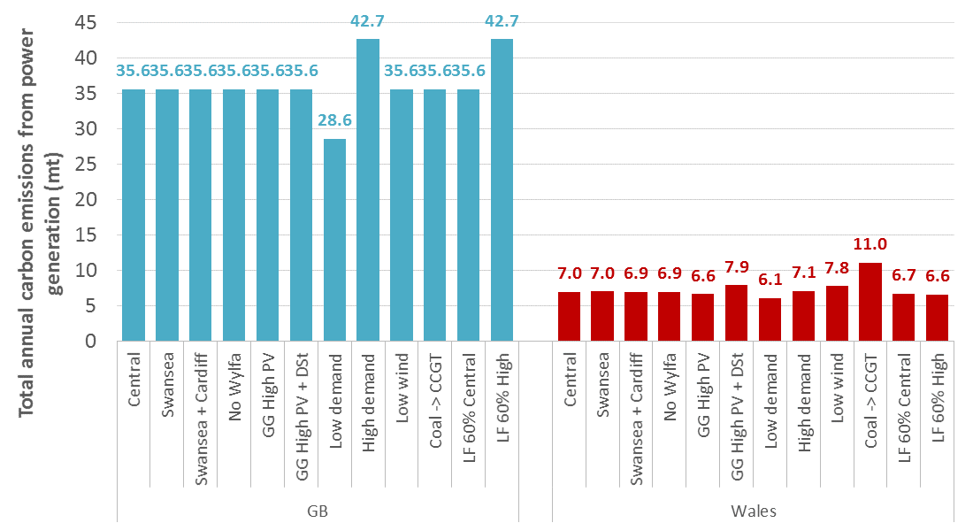
Annual carbon emissions (absolute)

Slide 6
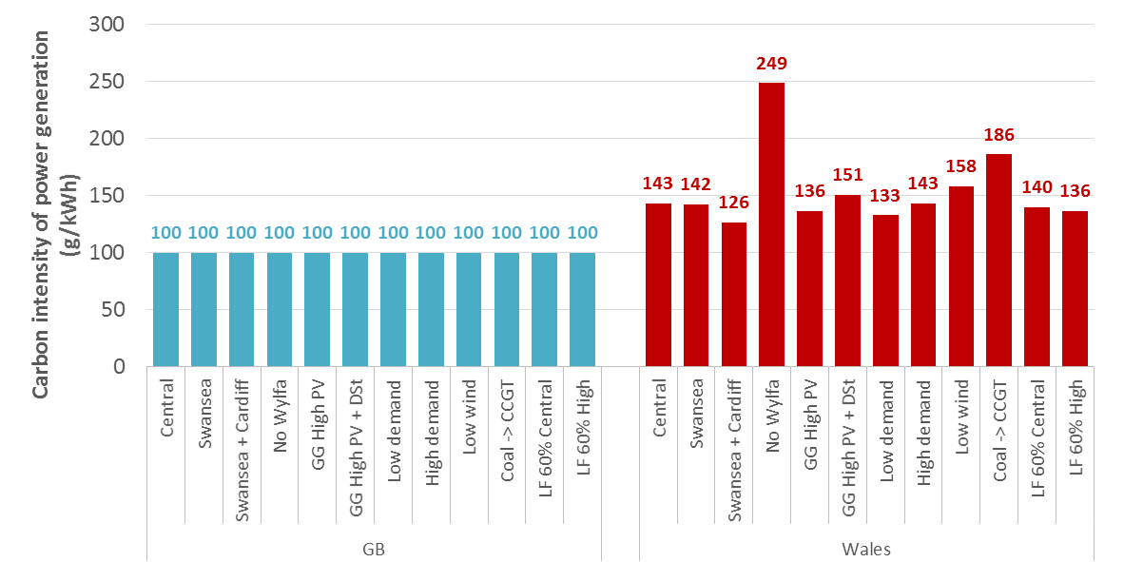
Annual carbon emissions (relative)
Addition of DSt increases Welsh emissions:
more storage → less CCS (outside Wales) required to hit carbon target → higher CCGT output achievable (in Wales)
GB emission target kept fixed
→ Welsh carbon intensity higher than GB average (proportionately higher share of existing CCGT than share of demand)

Slide 7
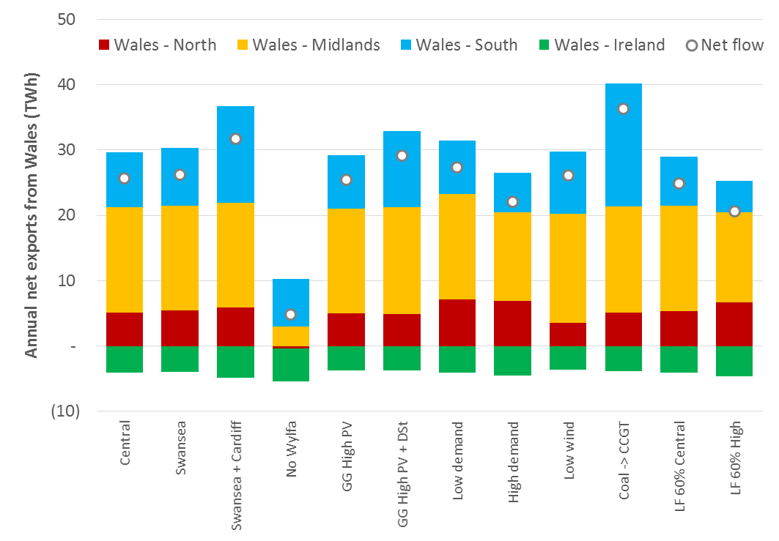
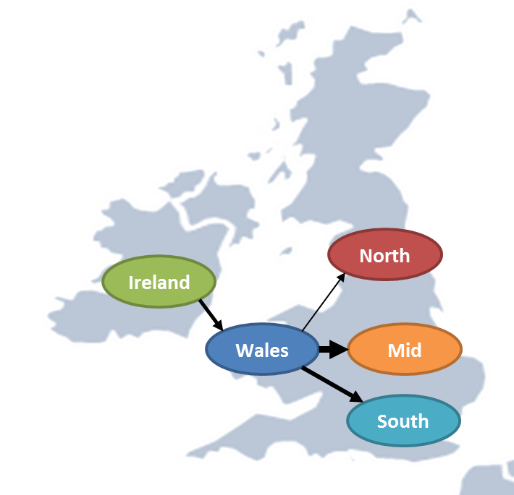
Annual energy exchanges between Wales and neighbouring regions/systems
Predominant net flow direction

